Slide 1
Ped=foot

Slide 2
Biped (n)
A creature with two feet

Slide 3
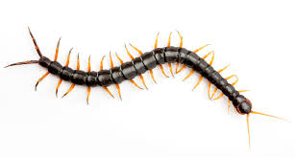
CENTIPEDE (N)
A creature with 100 feet

Slide 4
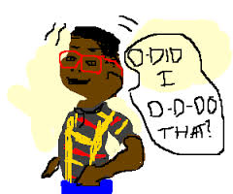
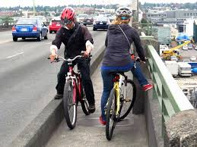
IMPEDIMENT (N)
Something that stands in one’s way; an obstacle

Slide 5
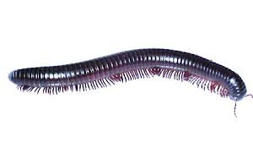
MILLIPEDE (N)
A creature with 1,000 feet

Slide 6
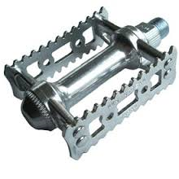
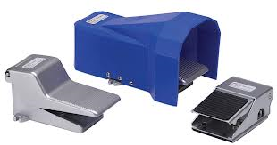
PEDAL (N)
A lever that is moved with one’s foot

Slide 7
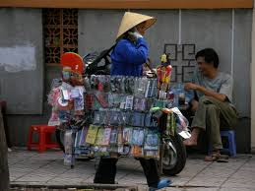
PEDDLER (N)
A person who goes from door to door selling their wares.

Slide 8
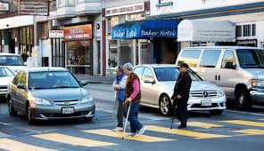
Pedestrian (N)
A person who walks across the street on foot.

Slide 9
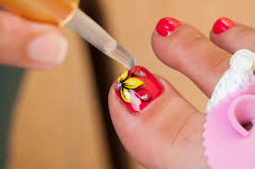
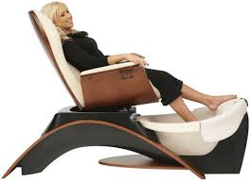
PEDICURE (N)
A foot treatment that could include soaking the feet and polishing the toenails

Slide 10
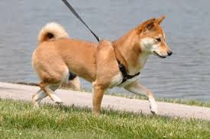
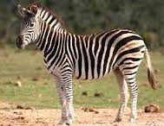
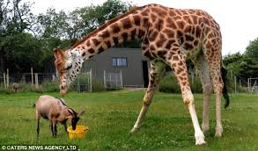
Quadruped(N)
A four-footed creature

Slide 11
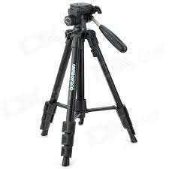
TRIPOD (N)
A three-footed stand often used to balance a camera

