Slide 1
Man, manu=hand

Slide 2
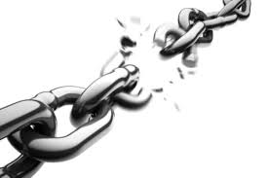
Emancipate (v) to set free; to lend a hand in freeing someone

Slide 3
Manacles (n) handcuffs

Slide 4
Manager (n) A person who has the upper hand; in charge

Slide 5
Mandate (n) An order or command placed in one’s hands

Slide 6
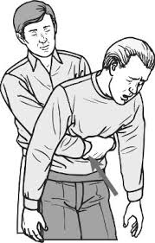
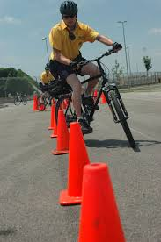
Maneuver (v) To handily or skillfully go around something

Slide 7
Manicure (n) A treatment for hands and nails

Slide 8
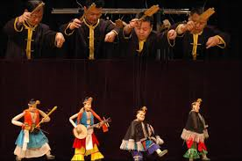
Manipulate (v) To skillfully operate by hand

Slide 9
Manual (n) A handbook; a book of directions

Slide 10
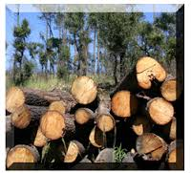
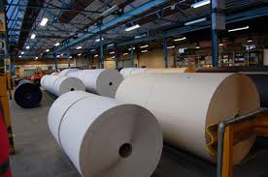
Manufacture (v) To make by hand or machine; to change raw material into a new product

Slide 11
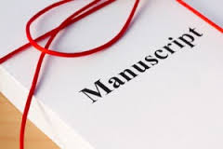
Manuscript (n) A handwritten or typed piece of writing such as a book

