Slide 1
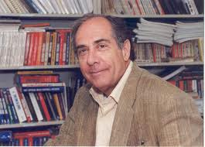
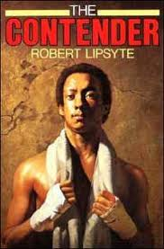
The Contender vocabulary
By Robert Lipsyte

Slide 2
Muhammad Ali vs George Foreman October 1974
https://www.youtube.com/watch?v=bVseoF1-p3M
Transition Activity (10 Minutes): Journal topic: Write about a time when you felt defeated.

Slide 3
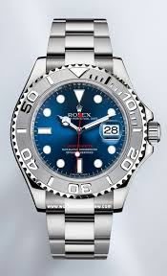
1. perpetual
Continuing without interruption

Slide 4
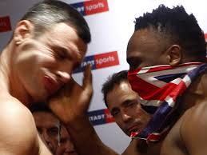
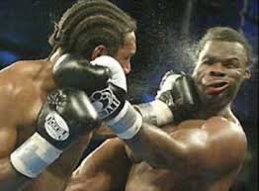
2. cuffing
Hitting with an open hand

Slide 5
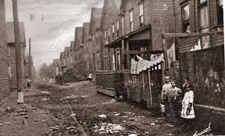
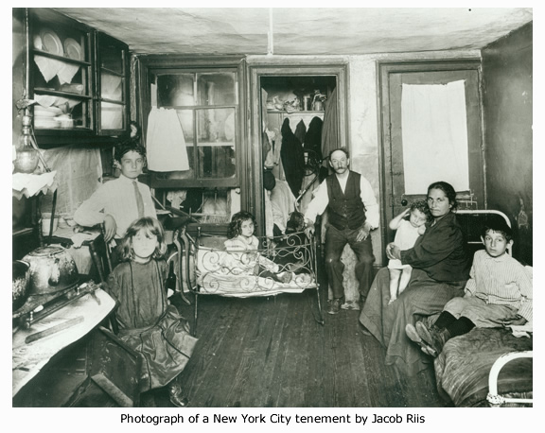
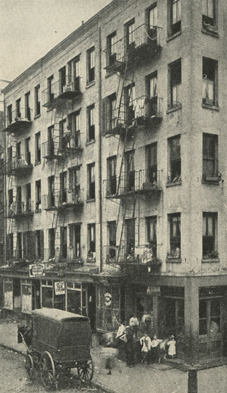
3. tenement
A rundown, low-rent apartment building

Slide 6
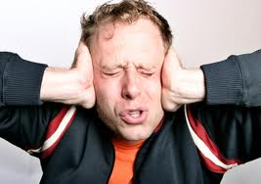
4. peal
A loud burst of noise

Slide 7
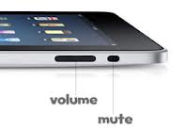
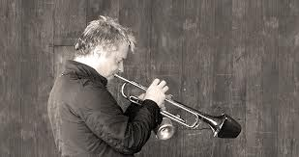
5. muted
Muffled; sound made soft by distance or interference

Slide 8
6. listlessness
Lifelessness, boredom; hum-drum

Slide 9
7. serene
Calm, unruffled

Slide 10
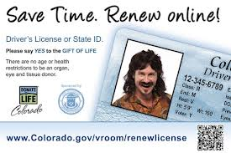
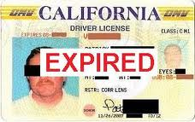
8. lapsed
Passed; expired

Slide 11
Now look for the answers to these questions as you read Chapters 1-4:
Who is Alfred Brooks?
How is Alfred different from the gang at the clubroom?
Why did Major, James, Hollis, and Sonny go to Epstein’s?
4. Why did Major, Hollis, and Sonny beat up Alfred?

Slide 12
Questions, continued:
5. When Aunt Pearl asked Alfred what had happened to him, what did he reply? Why?
6. Why did Alfred first go to Donatelli’s Gym?
7. What did Uncle Wilson always ask Alfred?
8. Before he went to bed Sunday night, Alfred thought, “…..Slave. Nothing’s promised you.” Explain his thoughts.

Slide 13
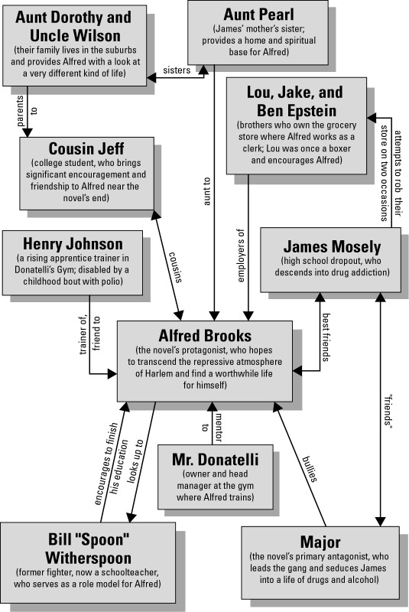
Characters

