Slide 1
Greek and Latin root words
Port
carry

Slide 2
deport
To carry or send away from a country; to banish

Slide 3
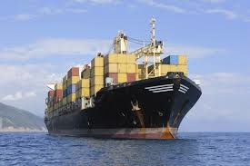
export
To carry out of the country

Slide 4
import
To carry into the country

Slide 5
portable
Capable of being easily carried

Slide 6
portage
The route over which boats and supplies are carried from one lake or river to another

Slide 7
porter
A n attendant who carries travelers’ luggage for them

Slide 8
portfolio
A case for carrying loose papers

Slide 9
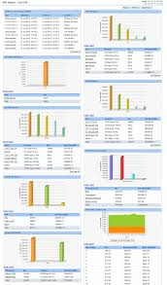
report
A collection of writing that carries information to be shared again with someone new

Slide 10
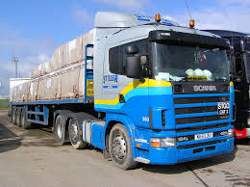
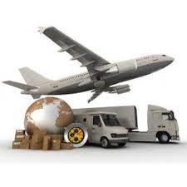
transport
To carry something from one place to another

Slide 11
support
To carry the weight of something

