Slide 1
Graph – writing
Vocabulary: Greek and Latin Root Words

Slide 2


autobiography
Writing about a person’s life written by that person

Slide 3
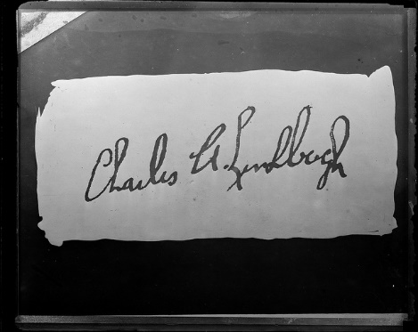
autograph
The writing of one’s own name

Slide 4
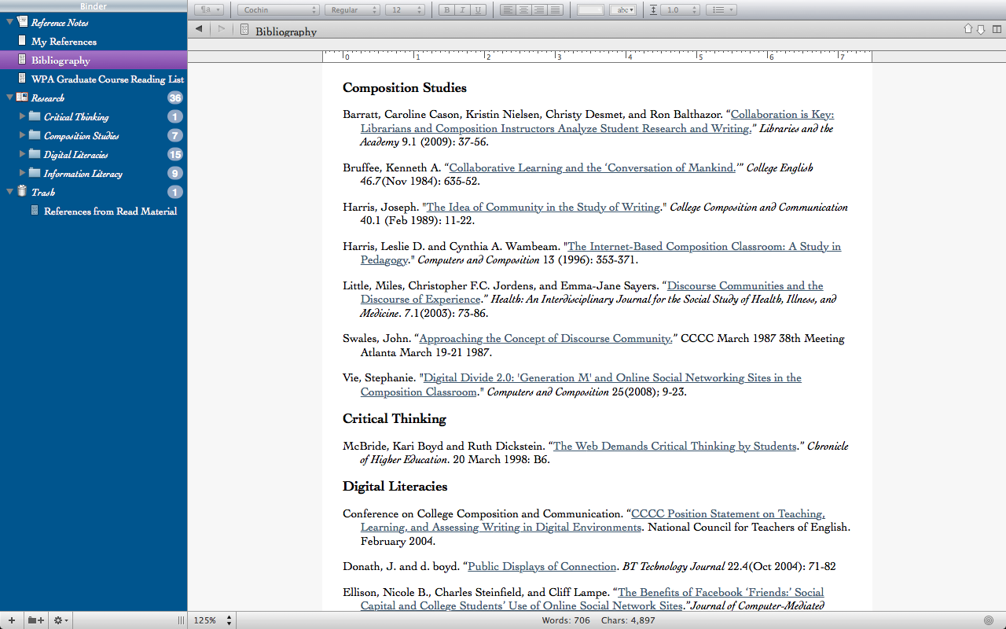
bibliography
The written list of books used in a report or book

Slide 5


biography
A written book about a person’s life

Slide 6
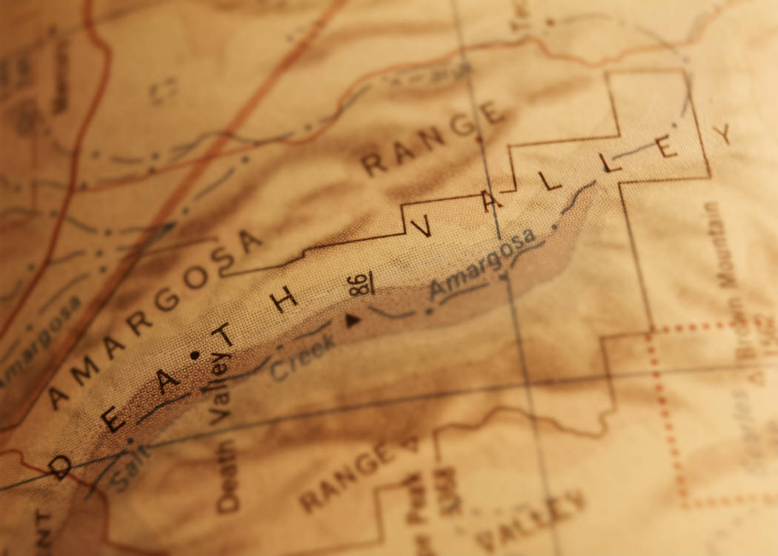
cartography
Mapmaking;
The writing involved in making maps or charts

Slide 7
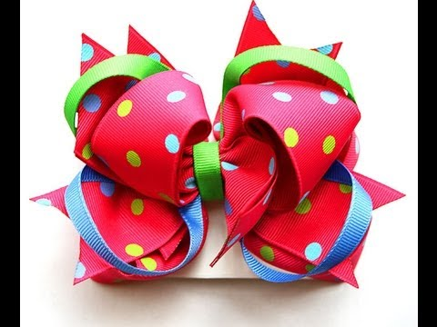
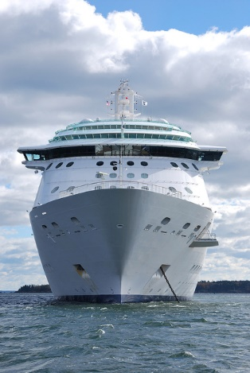
homograph
A word written the same way as another word but having a different meaning
  Example:
      Bow = hairbow
      Bow = take a bow or bow of a ship

Slide 8

paragraph
A section of writing that has a topic and concluding sentence

Slide 9
phonograph
Record player; a device that turns the writing on records into sound

Slide 10


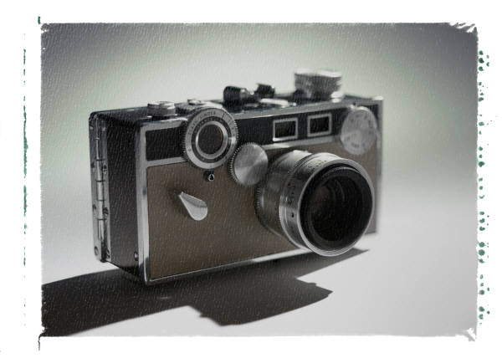
photography
The use of light to record an image using a camera

Slide 11
seismograph
A device that writes down (records) the movements of the earth

