Slide 1

Cred
Greek and Latin Root Words Vocabulary November 17, 2014

Slide 2
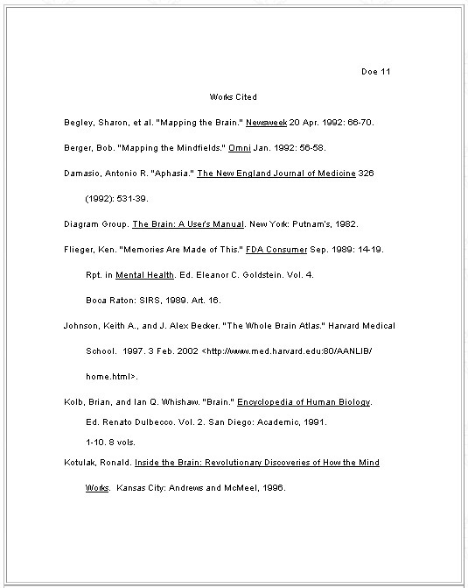

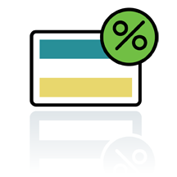
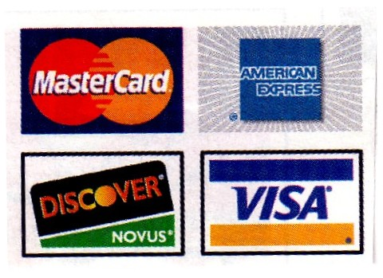
1. credit
(v) to believe that someone will do something

Slide 3
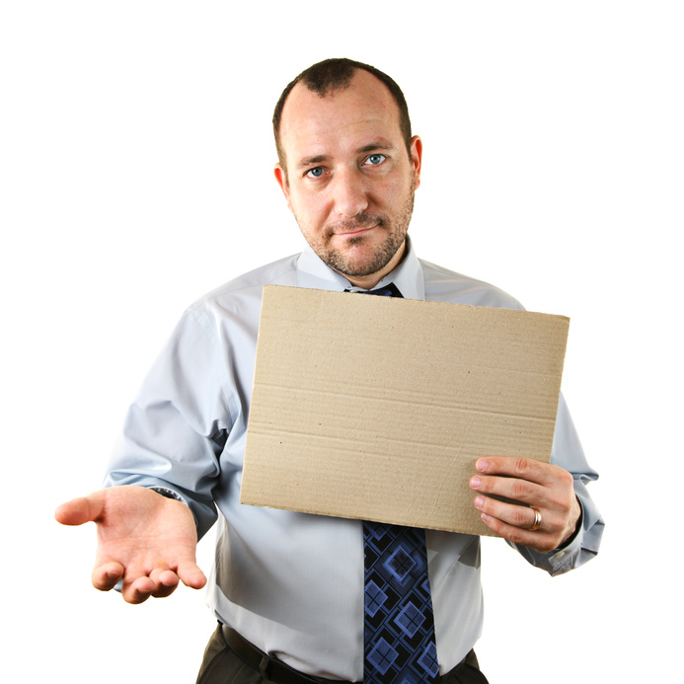

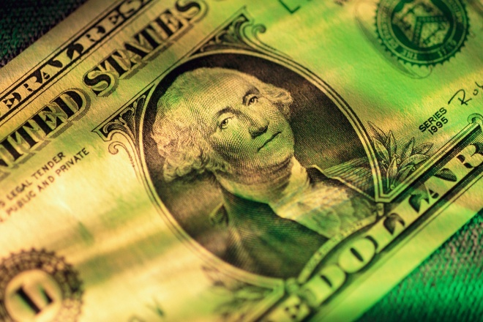
2. creditor
(n) a person who believes that he will be paid back for the money that he loaned.

Slide 4

3. credible
(adj) believable; reliable

Slide 5
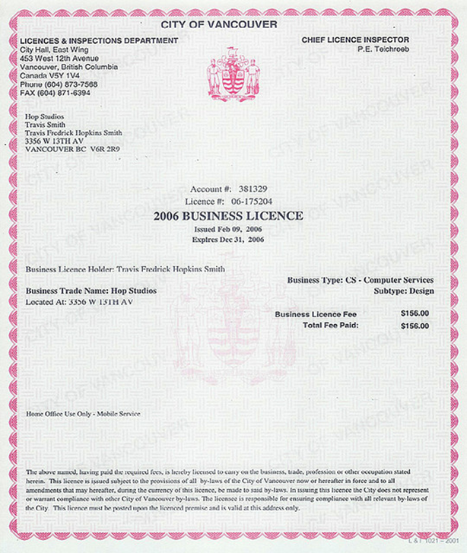
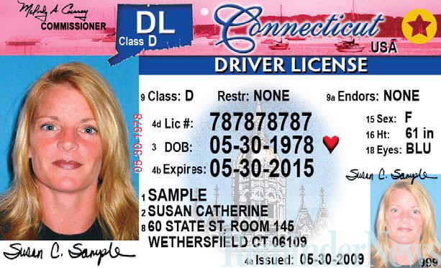
4. credential
(n) a document that proves that a person is believable

Slide 6

5. credulous
(adj) tending to believe too easily; easily convinced; easily fooled

Slide 7
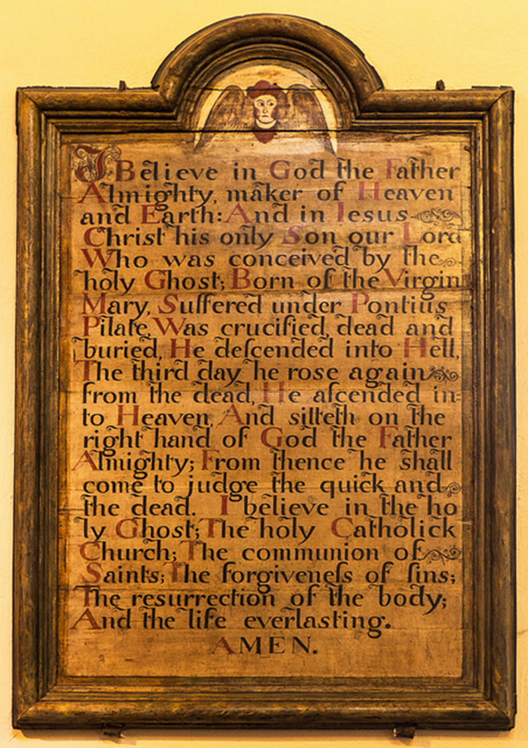
6. creed
(n) a set of religious beliefs or principles

Slide 8


7. accreditation
(n) granting approval or belief in a school.

Slide 9
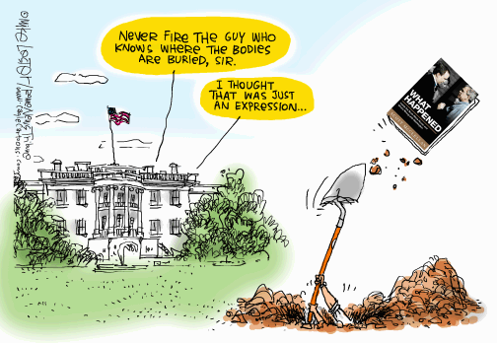
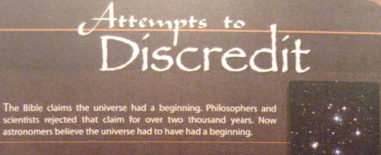
8. discredit
(v) to refuse to believe;
to reject as untrue

Slide 10
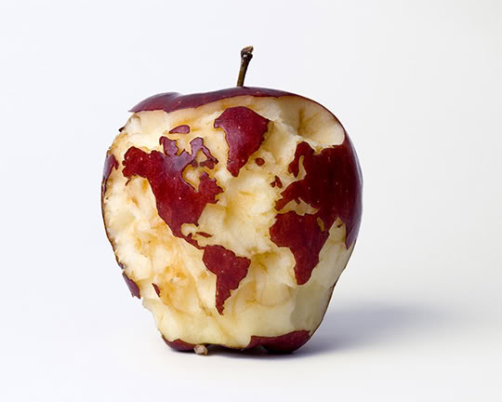

9. incredible
(adj) not believable; improbable; unlikely

Slide 11

10. incredulous
(adj) doubting; unwilling or unable to believe

